Slide 1

New York Trail
James E, Indigo H, Jiya S, Johnny W

Slide 2
Objective
New York Trail is a terminal based financial simulator during the 2008 financial crisis. The user chooses a characters and navigates through the economic landscape during the time person of June 2005 and June 2009.

Slide 3
Key Functionalities
Interactive gameplay: Decision making game with monthly actions such as working, investing and managing debt and savings
Historical event accuracy: Incorporates real-world market events such as the Lehman Brothers collapse and S&P 500 data visualization
Character options: Choose between two characters with distinct starting points and risk profiles
Random events: unexpected scenarios that can impact personal metrics
Win Condition: Survive until June 2009 with a positive net worth while maintaining health, reputation and stress levels

Slide 4
Generative AI prompts
I need you to develop a prompt for a LLM to properly understand and produce suitable code for this idea, let's keep most of what you’ve already come up with but also add this in Two Characters, both college grads, 4 years into their career. -Hudson 6,500 Savings Income: 62,000 yearly Initial Risk Rating: 5.5 -Jane -8k Debt Income: 80,000 yearly Initial Risk Rating: 2.0 Risk rating of 10.0 means 80% of financial investments will fail, 1.0 is 99.9% success. Create this prompt, and then also provide a function to display the last 52 weeks of sp 500 data based on the time our player is in. Display it in matplotlib for 25 seconds before auto closing. I think the game should also go from june 05 to june 09, allowing players to play a month every turn.

Slide 5
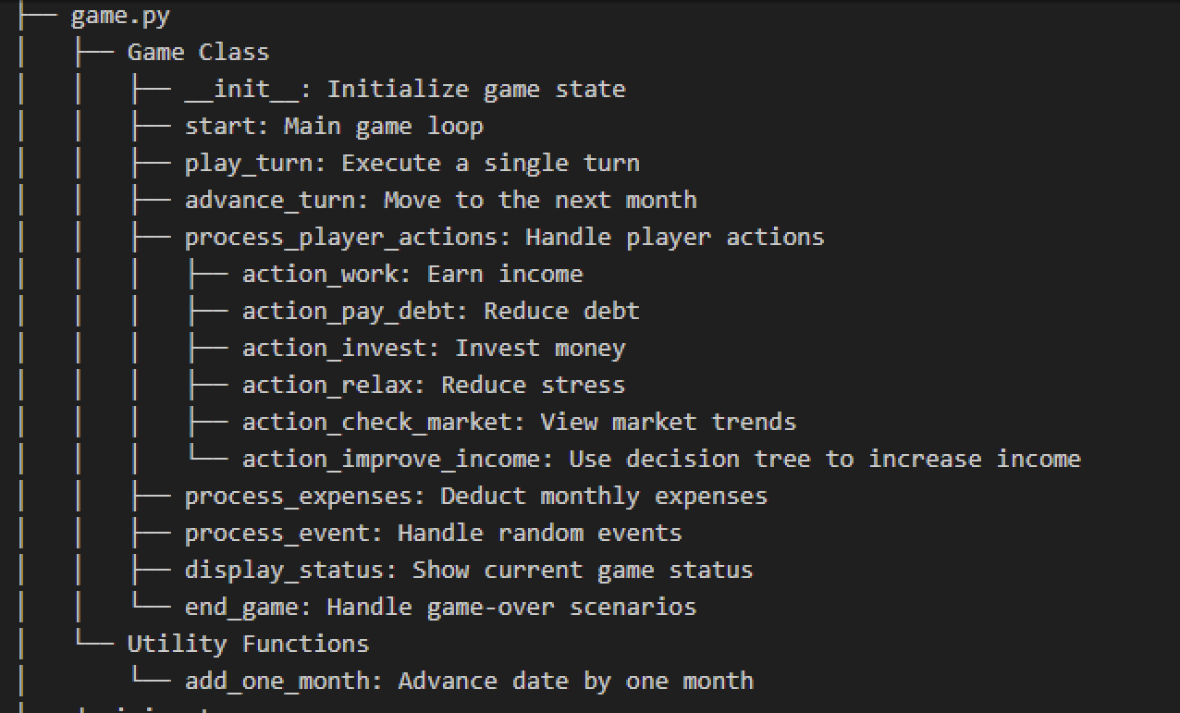
Visual representation

Slide 6
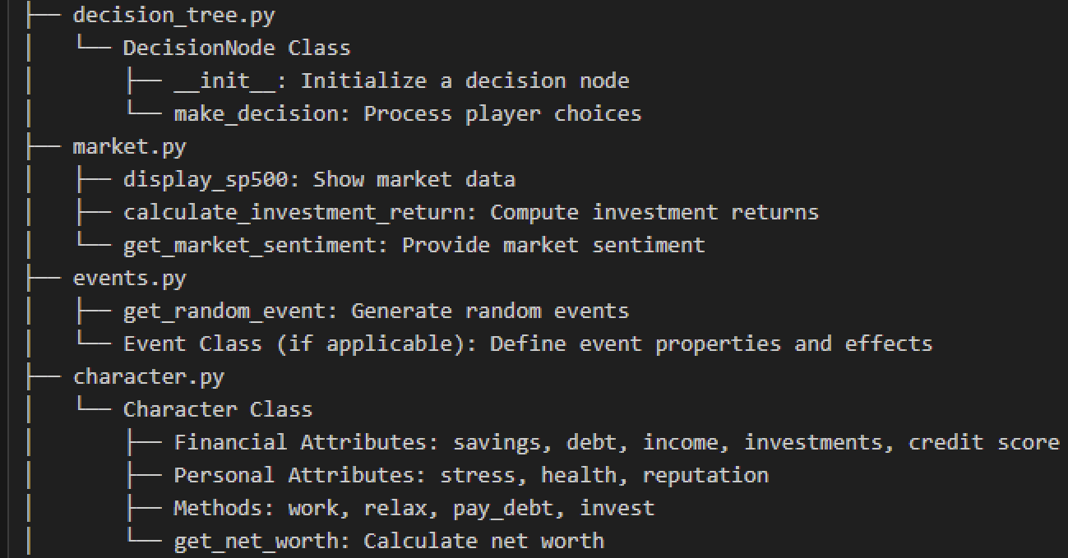
Visual representation

Slide 7
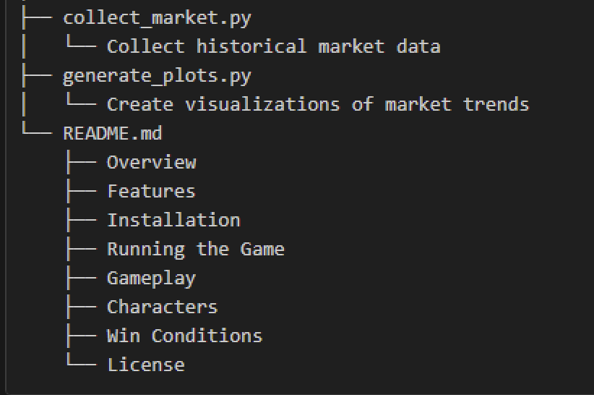
Visual representation

Slide 8
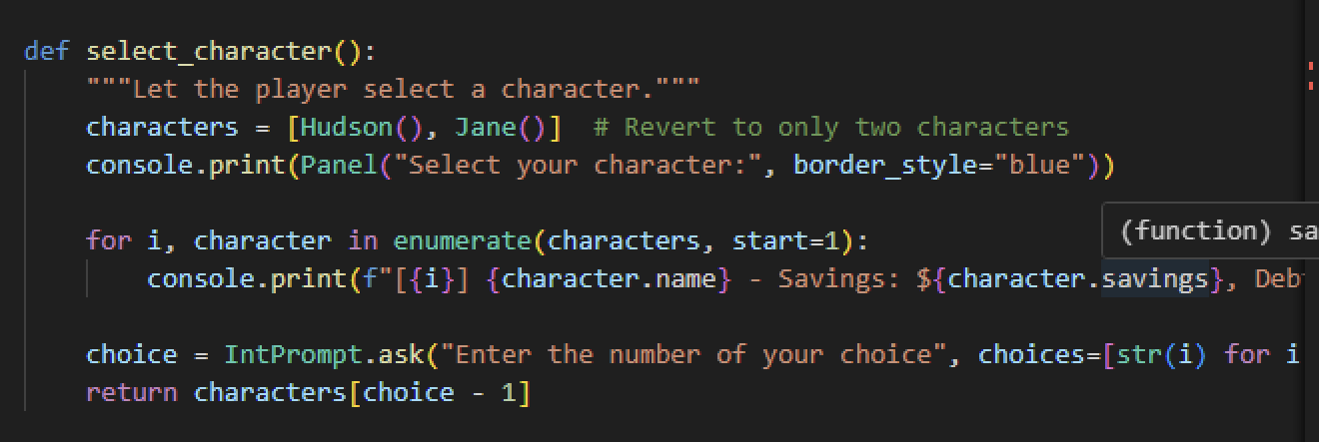
Code Snippets
select_character(main.py)- lets user choose characters and sets inital conditions for charecter

Slide 9
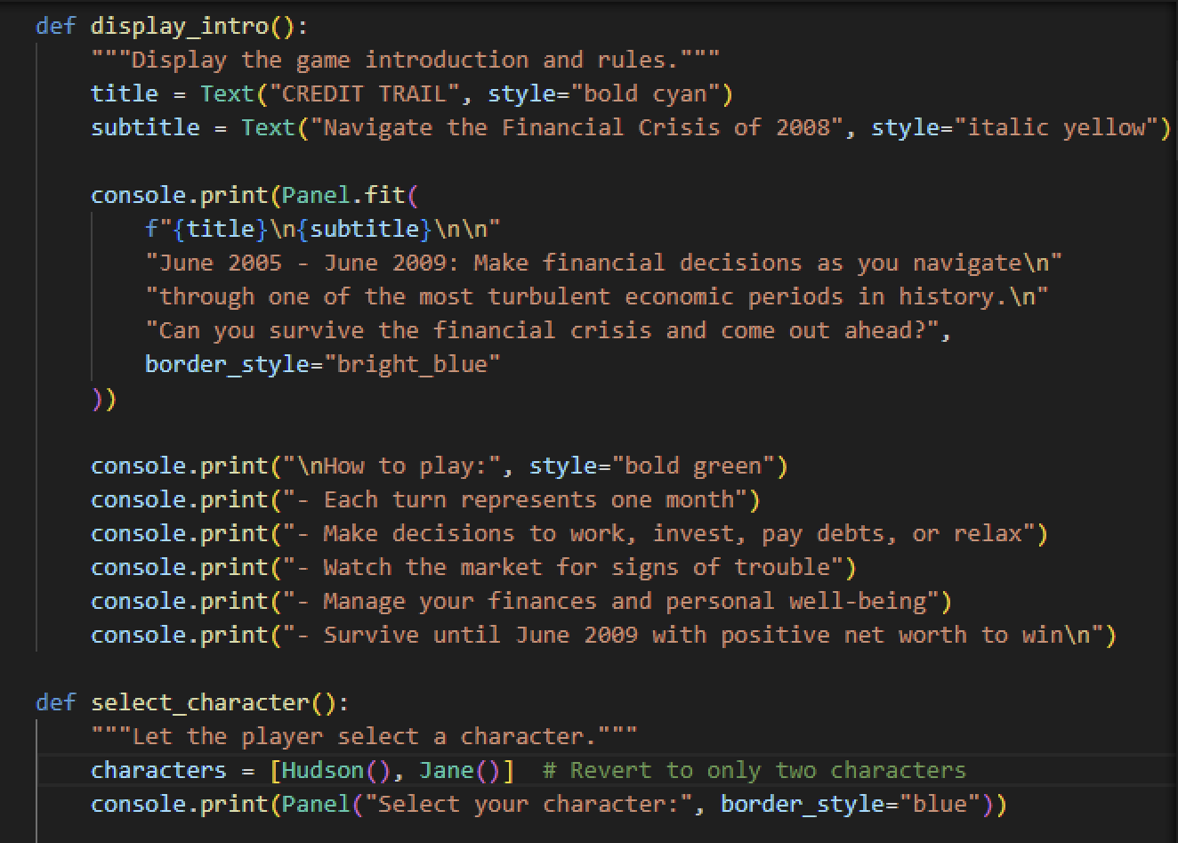
Code Snippets
display_intro(main.py)- Introduces the game, rules, objective and characters

Slide 10
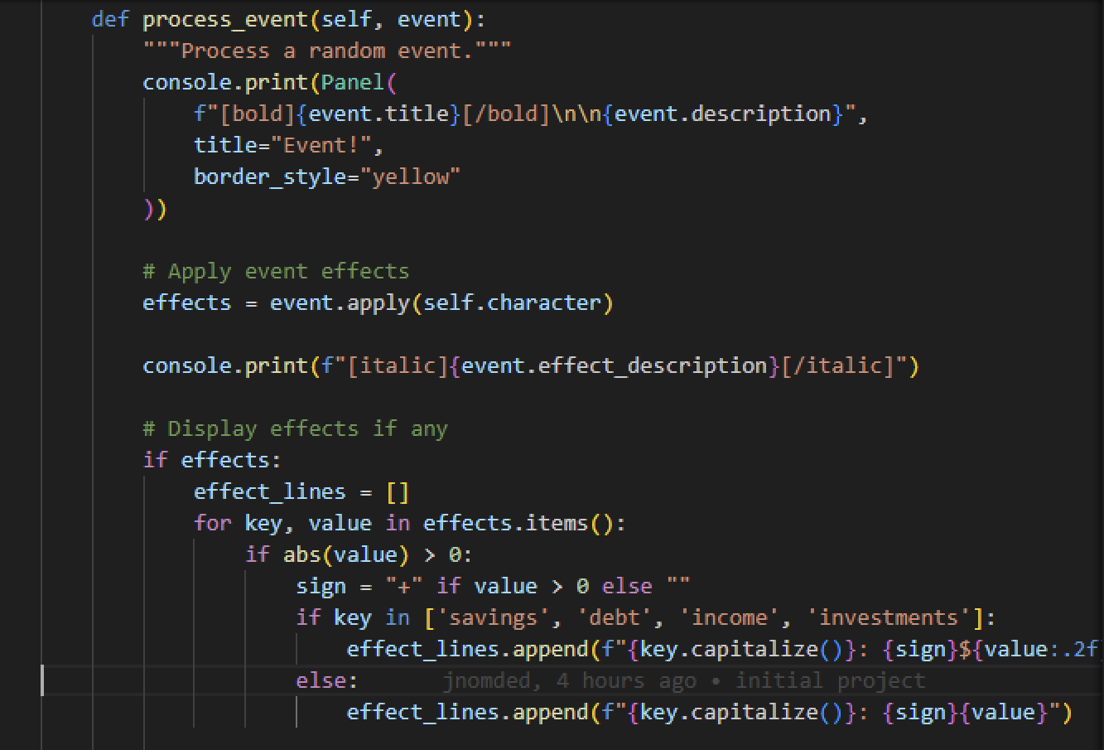
Code Snippets
process_event(game.py )- Handles random events that occur during the game and how they affect the character

Slide 11
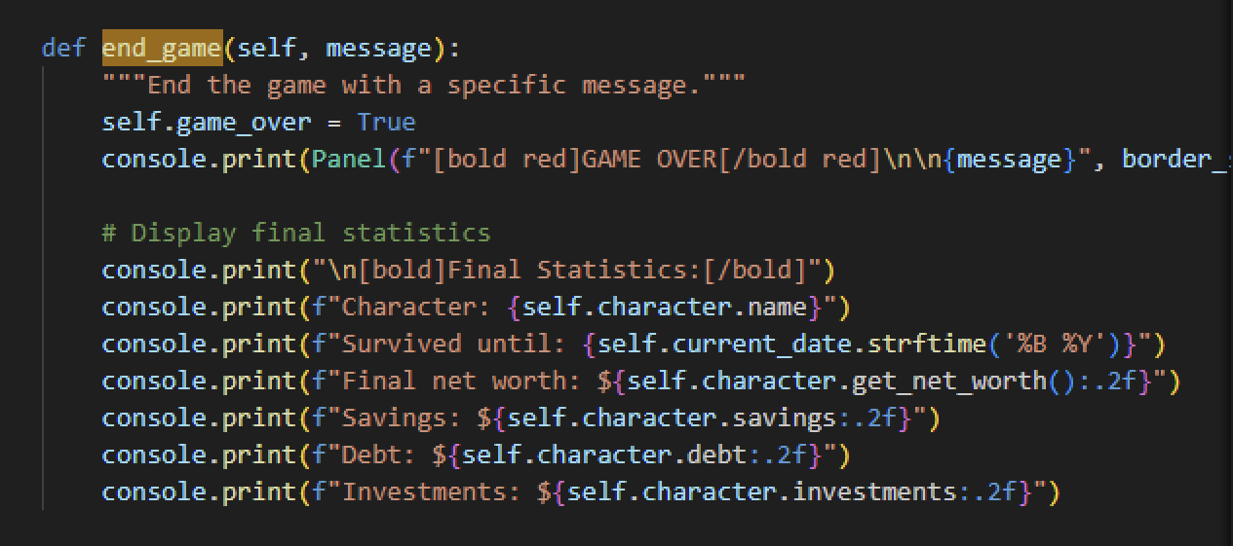
Code Snippets
end_game(game.py)- Handels the end conditions of the game. Called when a player meets a failure condition or if the player successfully completes the game.

Slide 12
GenAI Uses

Slide 13
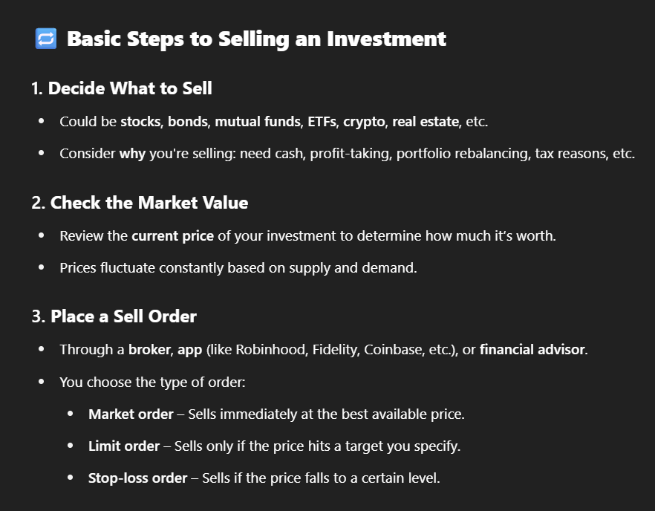
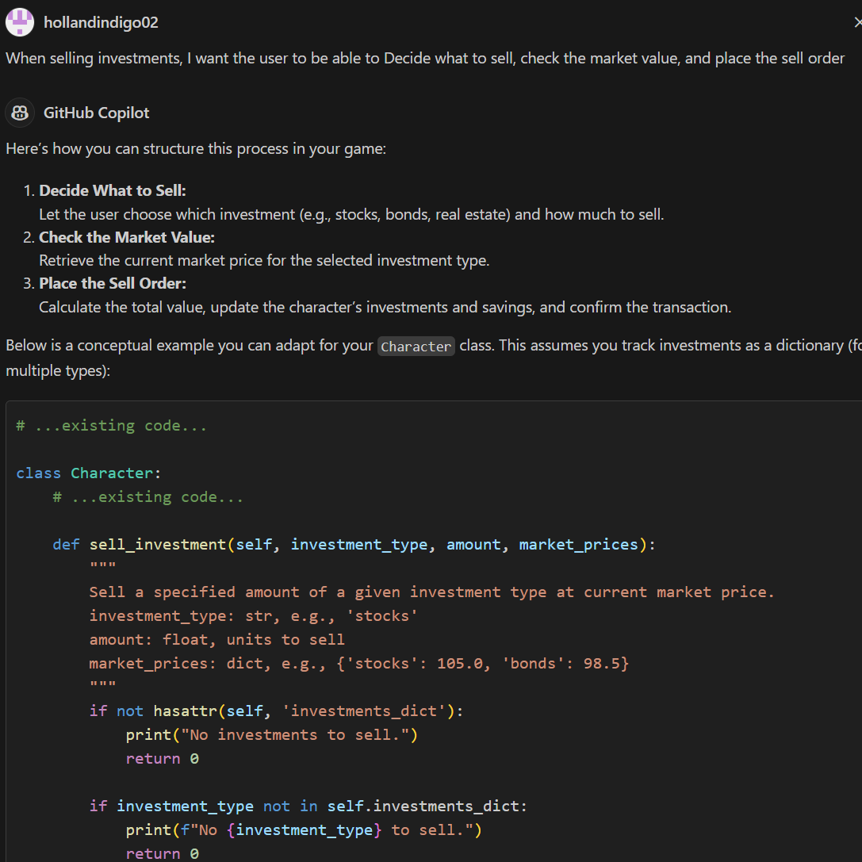
Prompt Chaining
Using the answers of one GenAI model as the prompt for a separate model
Chat-GPT
“How does selling investments work?”

Slide 14
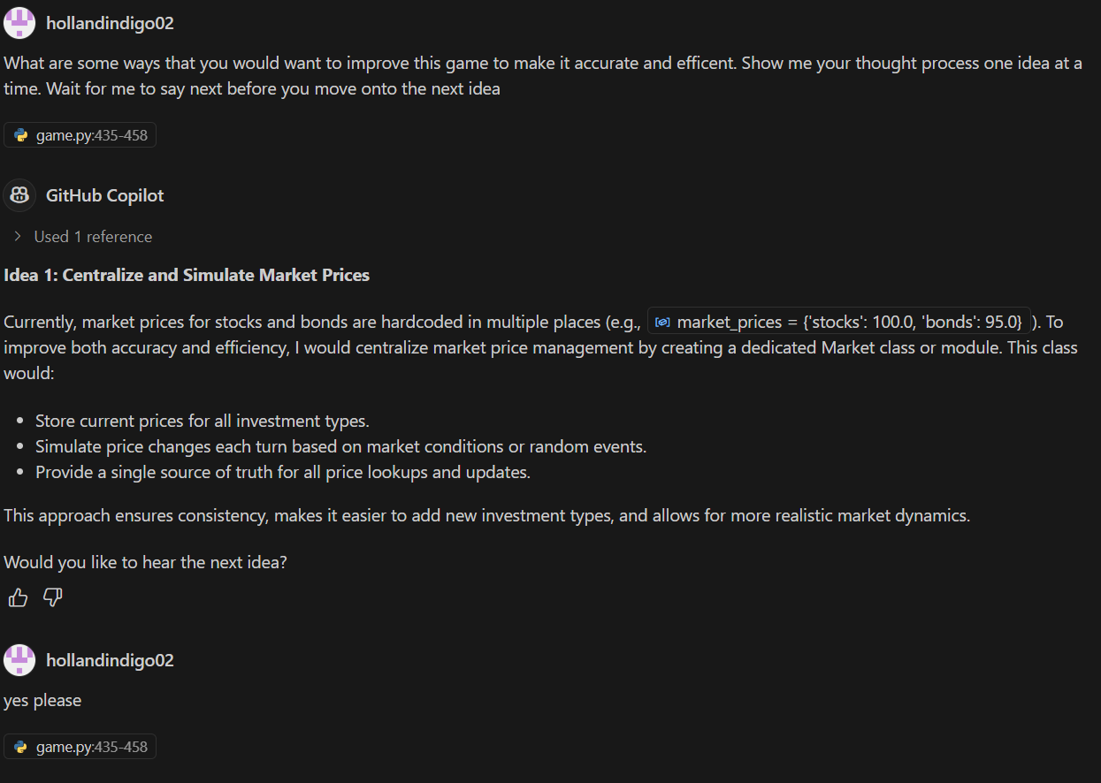
Prompt Chaining
Asking for one suggestion/idea at a time

Slide 15
More Gen-AI uses
Role Playing
“You are tasked with writing a Python program for an interactive, terminal-based, turn-based financial simulator game called “New York Trail,” set against the backdrop of the build-up to the 2008 financial crisis. The game timeline spans from June 2005 to June 2009, with each turn representing one month of play.”

Slide 16
DEMO

